Slide 1







ISOTOPe story time
WHAT ARCHITECTURE WILL WORK?
03
23
MLP
Conv VAE
Transformer
CNN
04
23
HOW TO OPTIMIZE THE MODEL
0623
The Endline
Comet ML
vs.
Optuna
WHAT IS ISOTOP
0223
WHAT ENVIRONMENT TO USE
04
23
Google Colab
vs
Jupyter notebook
Everything is figure-out-able
05
23
Hyak !!

Slide 2
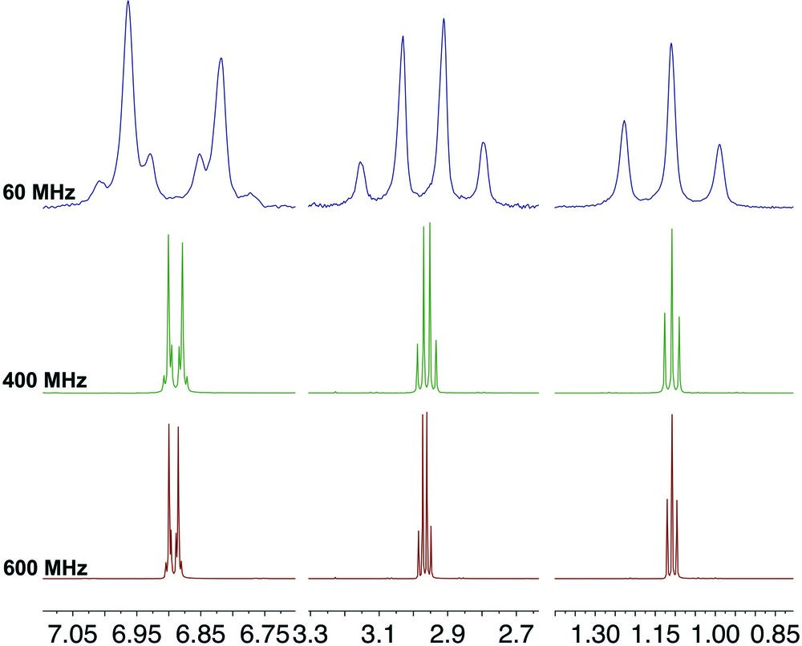

WHAT IS ISOTOPE
ISOTOPE

Slide 3
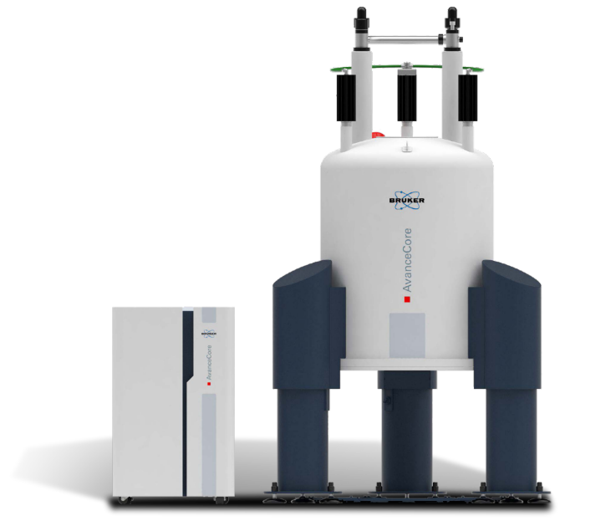
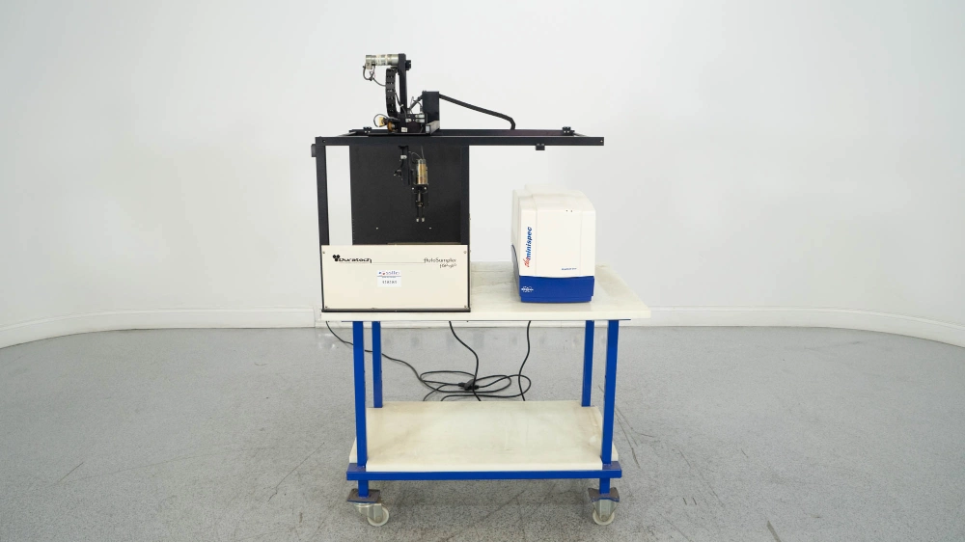
What is isotopE
60 MHz NMR system
ISOTOPE
400 MHz NMR system

Slide 4
ISOTOPe story time
WHAT ARCHITECTURE WILL WORK?
03
23
MLP
Conv VAE
Transformer
CNN
04
23
HOW TO OPTIMIZE THE MODEL
0623
The Endline
Comet ML
vs.
Optuna
WHAT IS ISOTOPE
0223
WHAT ENVIRONMENT TO USE
04
23
Google Colab
vs
Jupyter notebook
Everything is figure-out-able
05
23
Hyak !!

Slide 5
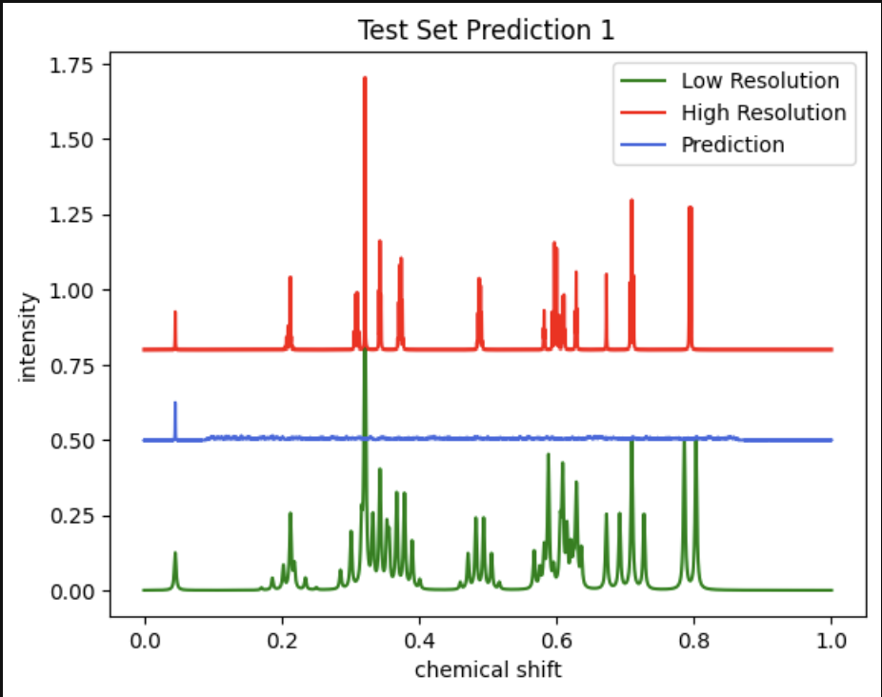
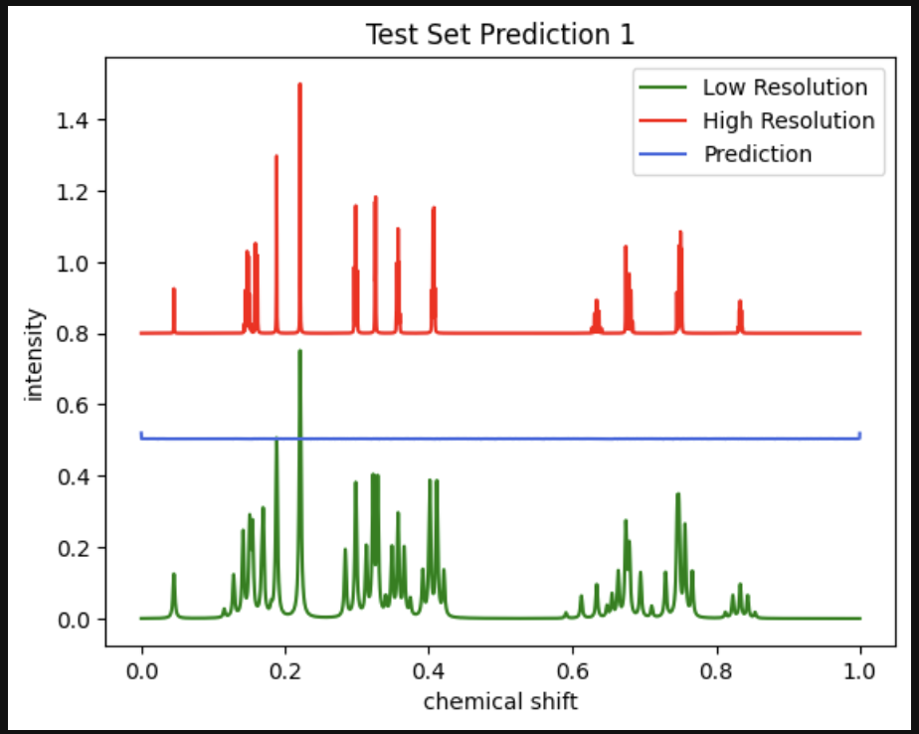
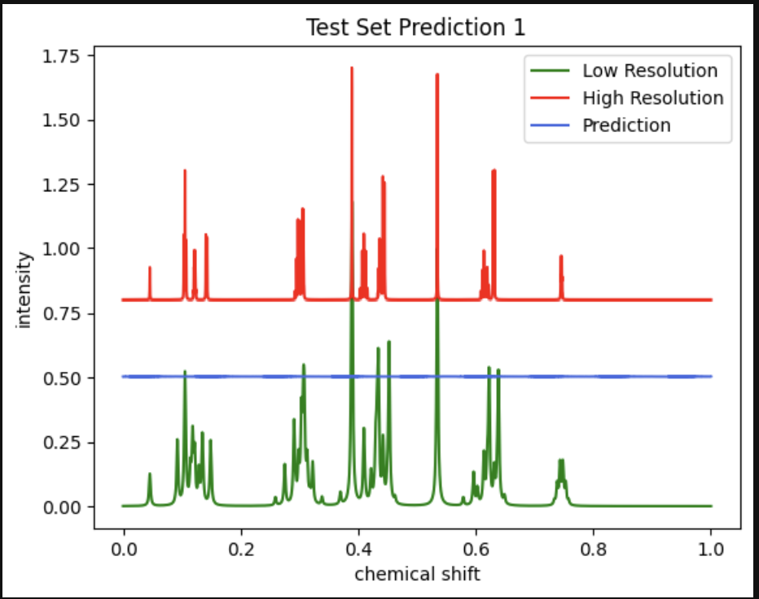
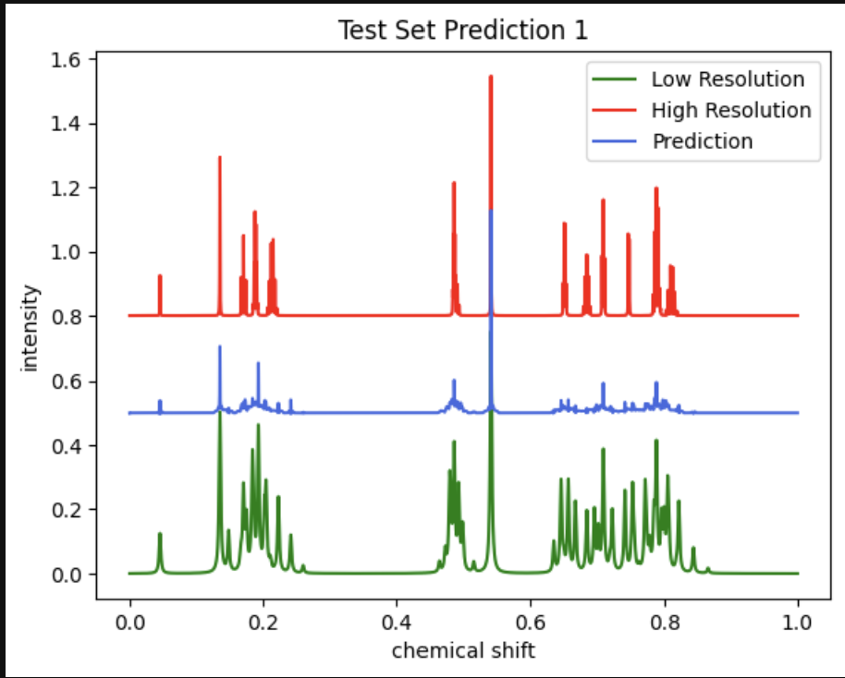
WHAT ARCHITECTURE WILL WORK?
MLP
Conv VAE
Transformer
CNN

Slide 6
WHAT ARCHITECTURE WILL WORK?
CNN

Slide 7
ISOTOPe story time
WHAT ARCHITECTURE WILL WORK?
03
23
MLP
Conv VAE
Transformer
CNN
04
23
HOW TO OPTIMIZE THE MODEL
0623
The Endline
Comet ML
vs.
Optuna
WHAT IS ISOTOPE
0223
WHAT ENVIRONMENT TO USE
04
23
Google Colab
vs
Jupyter notebook
Everything is figure-out-able
05
23
Hyak !!

Slide 8
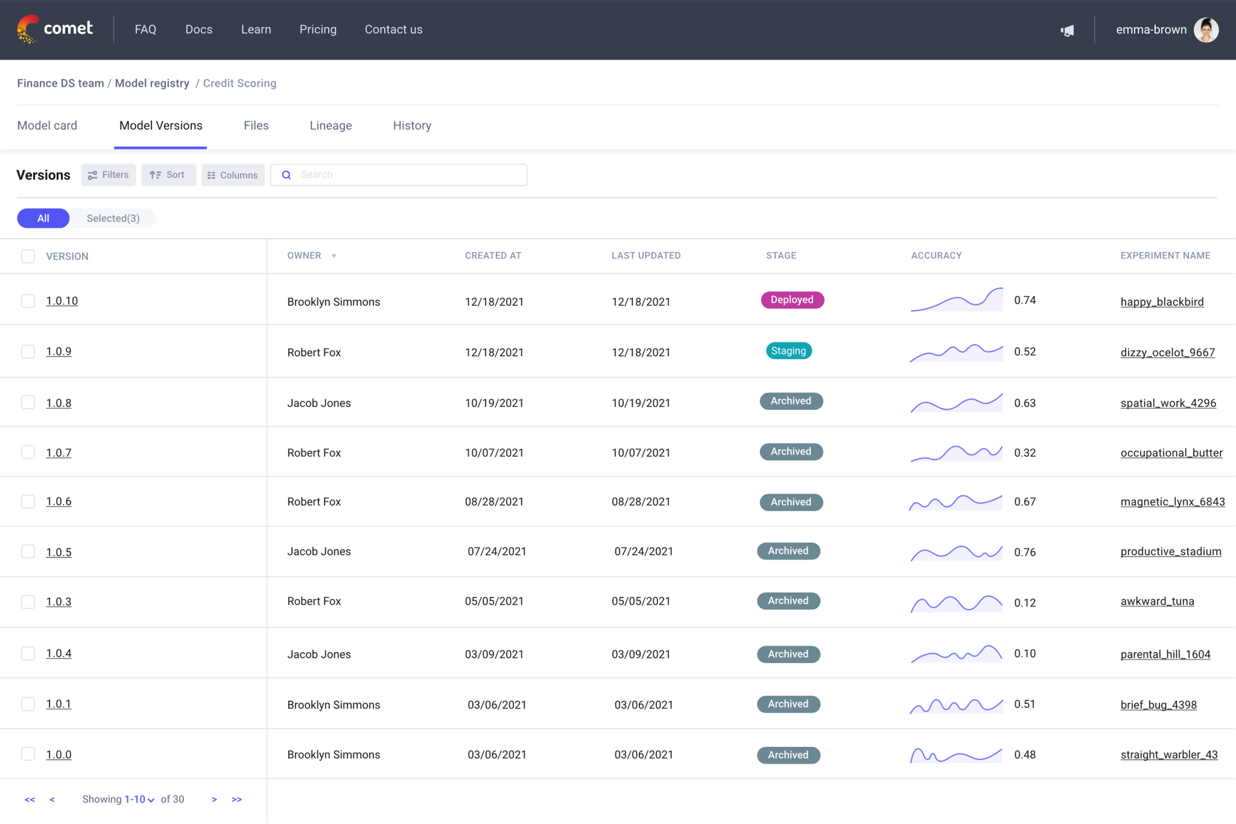
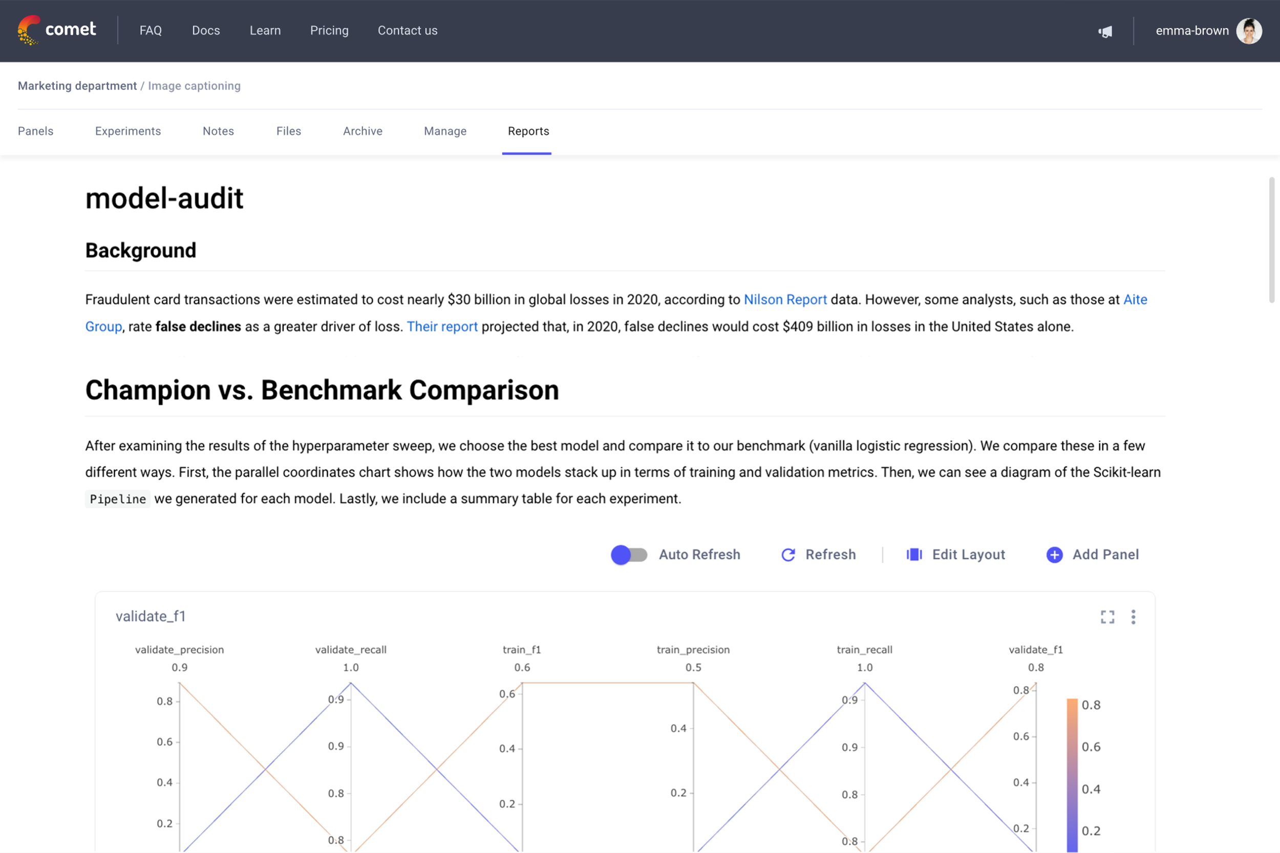
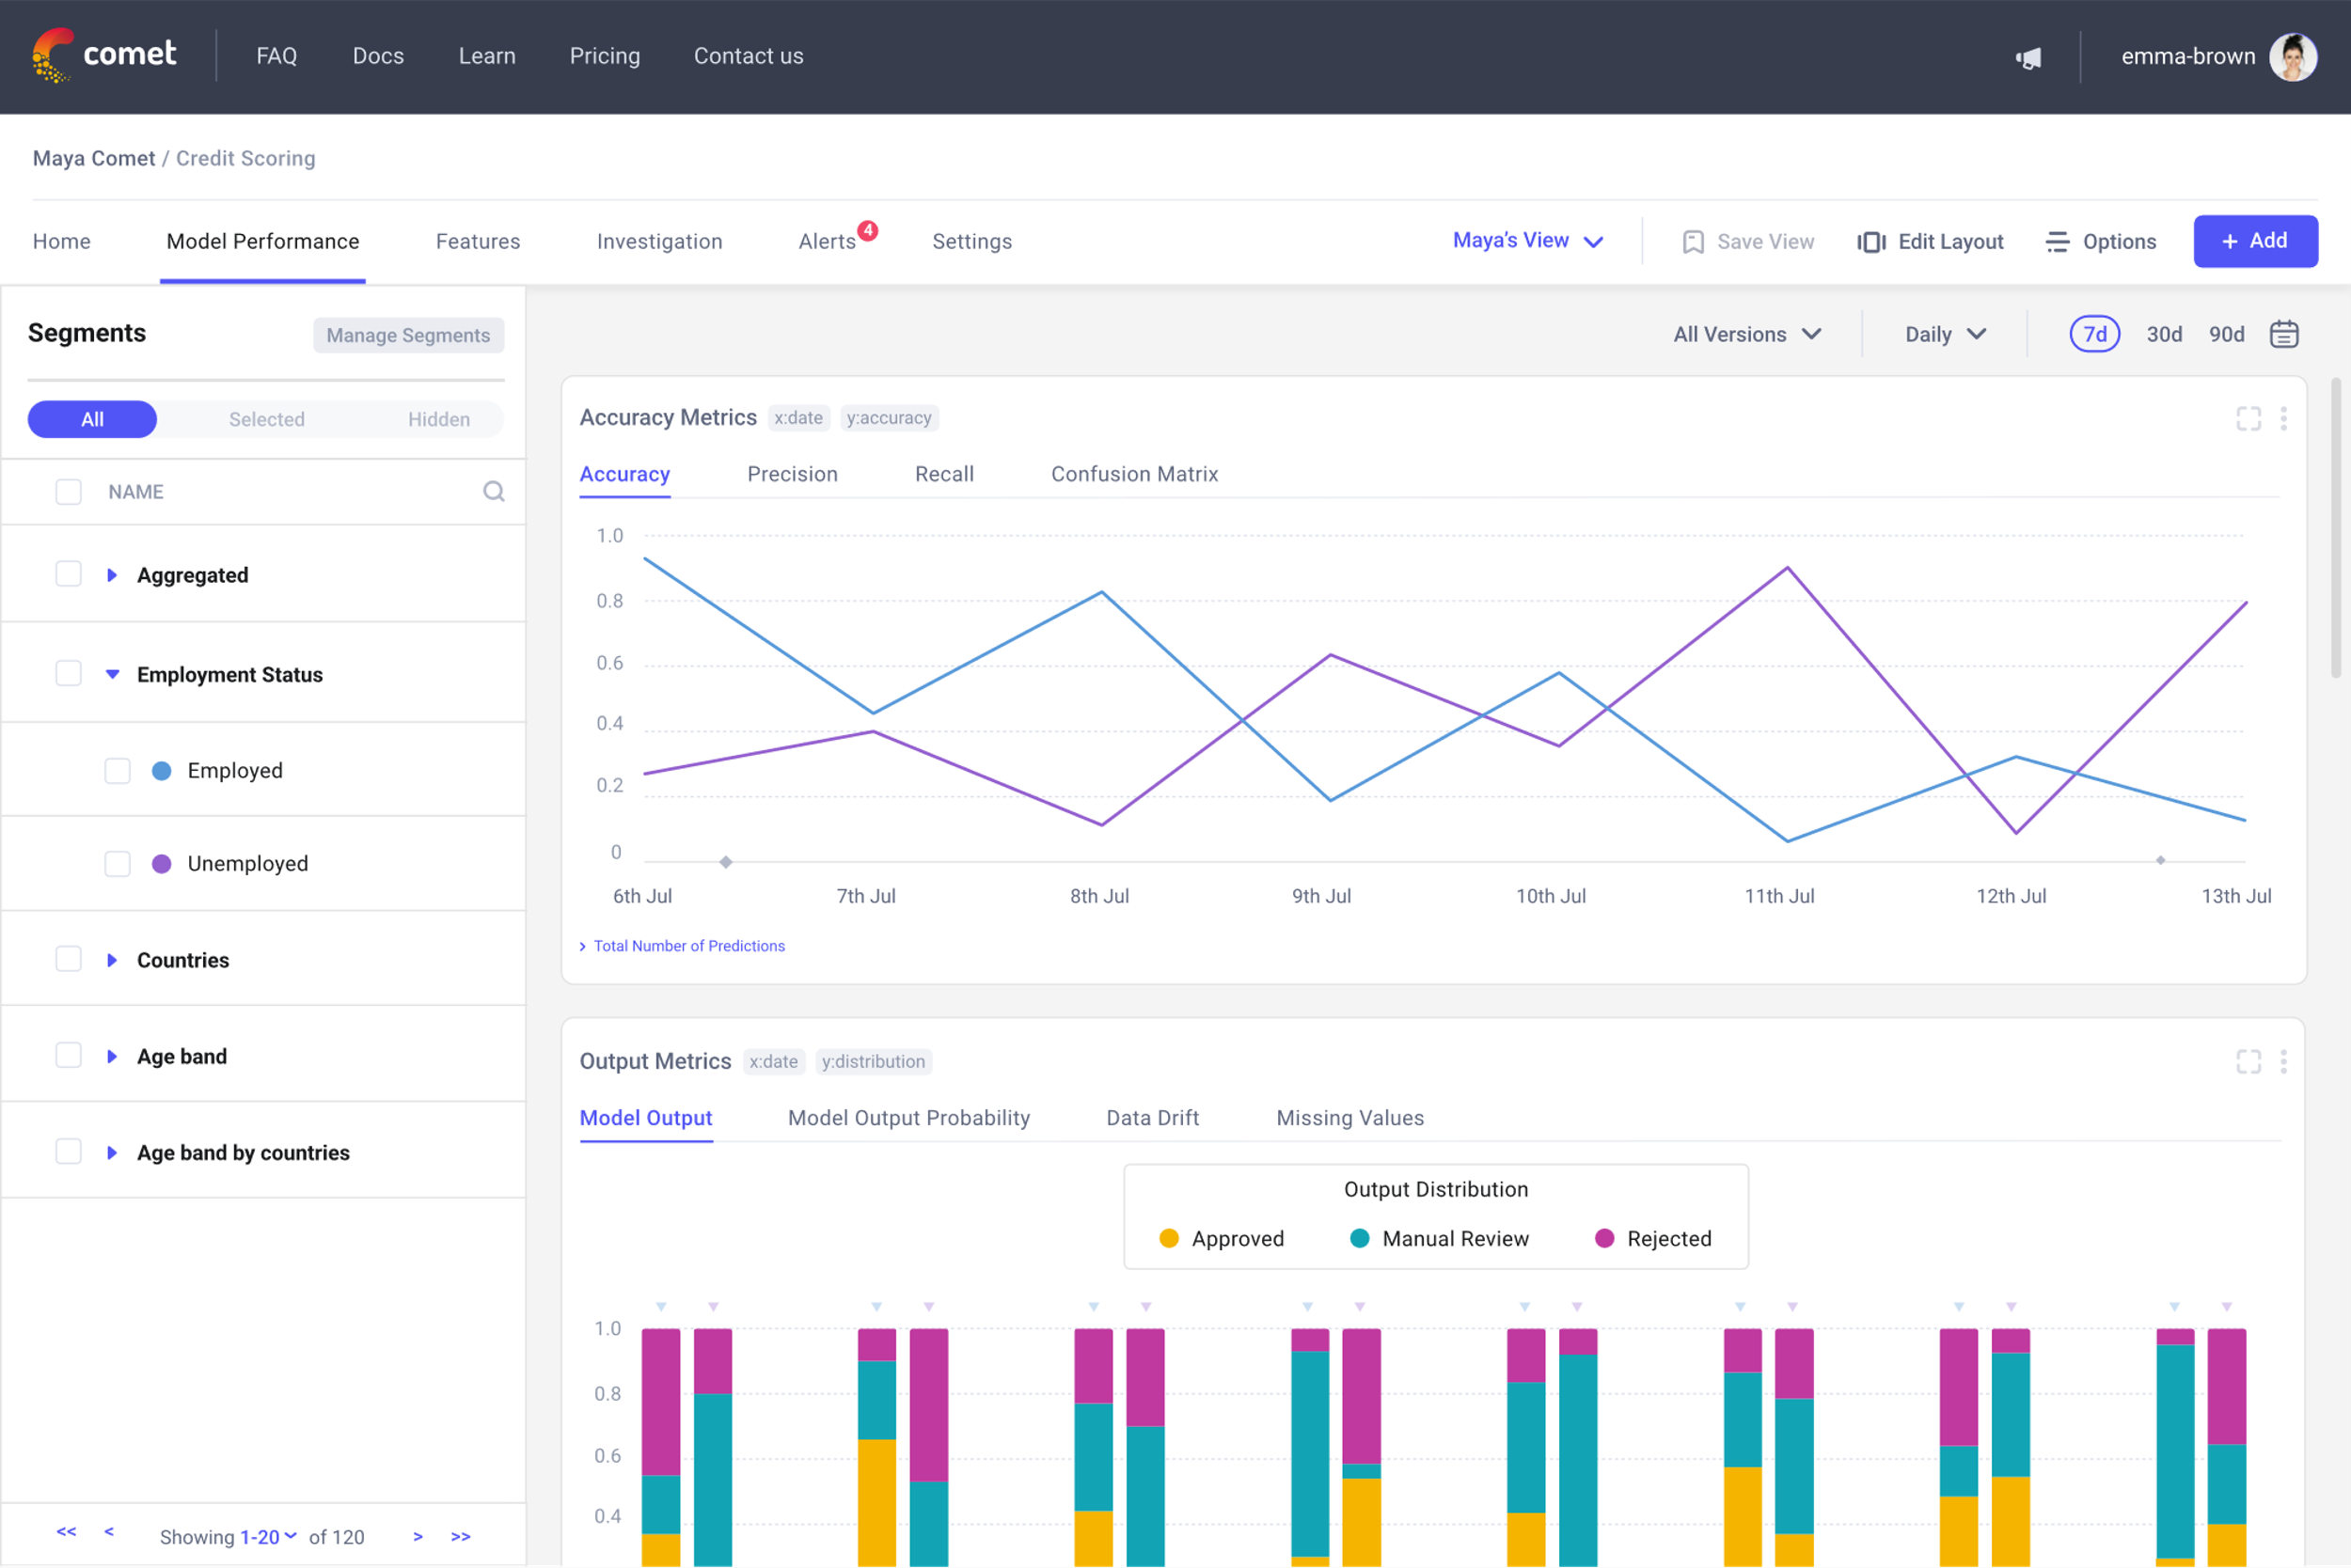

HOW TO OPTIMIZE THE MODEL
Comet ML can be used to Manage, Visualize, and Optimize machine learning models

Slide 9
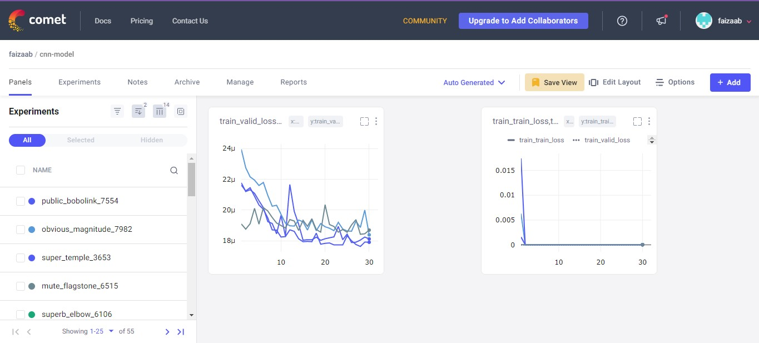

HOW TO OPTIMIZE THE MODEL
import comet_ml
experiment = comet_ml.Experiment()
experiment.log_metric('acc', acc)
experiment.log_parameter('batch_size', batch_size)
experiment.end()
The free version of the code : from comet_ml import Experiment
experiment = Experiment(
api_key="gT6S0qZpb50idSfM01s4q2uQS",
project_name="CNN_model",
workspace="faizaab",
auto_metric_logging=True,
auto_param_logging=True,
log_graph=True,
auto_metric_step_rate=True,
parse_args=True,
auto_histogram_epoch_rate=True,)
The free version of Comet ML only includes cod for logging experiment parameters

Slide 10


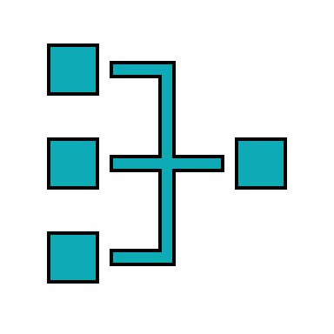


HOW TO OPTIMIZE THE MODEL
Easy parallelization
Parallelize hyperparameter searches over multiple threads or processes without modifying code
Eager search spaces
Automated search for optimal hyperparameters using Python conditionals, loops, and syntax
State-of-the-art algorithms
Efficiently search large spaces and prune unpromising trials for faster results

Slide 11
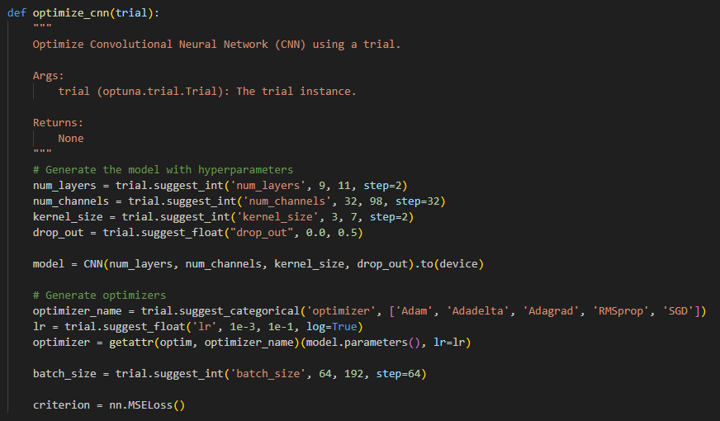
HOW TO OPTIMIZE THE MODEL
Optimize all the parameters in one function
2 -3 options for most parameter

Slide 12

HOW TO OPTIMIZE THE MODEL
Optimize all the parameters in one function
2 -3 options for most parameter
GPU limit passed before we started

Slide 13
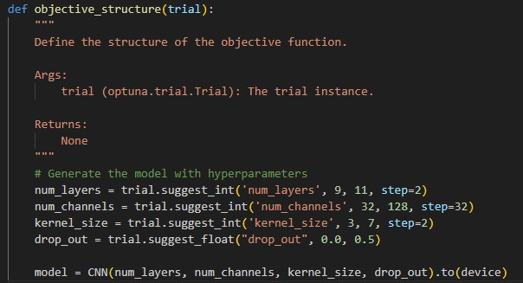
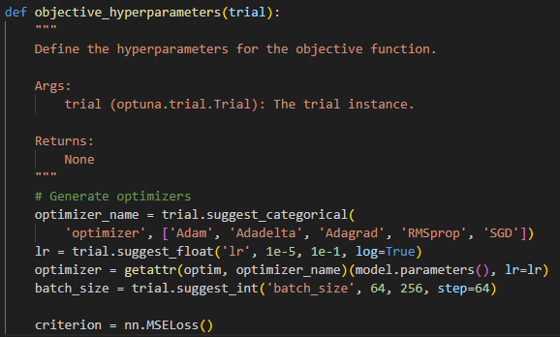
HOW TO OPTIMIZE THE MODEL
Get the best model structure
Get the best hyper-parameter

Slide 14

HOW TO OPTIMIZE THE MODEL
Get the best model structure
Get the best hyper-parameter

Slide 15
ISOTOPe story time
WHAT ARCHITECTURE WILL WORK?
03
23
MLP
Conv VAE
Transformer
CNN
04
23
HOW TO OPTIMIZE THE MODEL
0623
The Endline
Comet ML
vs.
Optuna
WHAT IS ISOTOPE
0223
WHAT ENVIRONMENT TO USE
04
23
Google Colab
vs
Jupyter notebook
Everything is figure-out-able
05
23
Hyak !!

Slide 16





WHAT ENVIRONMENT TO USE
Not enough GPU
We have all the libraries
Connected to GitHub

Slide 17


WHAT ENVIRONMENT TO USE
Not Connected to GitHub
Pip install all the libraries
GPU access but not plenty

Slide 18



WHAT ENVIRONMENT TO USE
Not Connected to GitHub
Pip install all the libraries
GPU access but not plenty
Installed all needed libraries
Update through Jupyter notebook, VSC, or terminal

Slide 19
ISOTOPe story time
WHAT ARCHITECTURE WILL WORK?
03
23
MLP
Conv VAE
Transformer
CNN
04
23
HOW TO OPTIMIZE THE MODEL
0623
The Endline
Comet ML
vs.
Optuna
WHAT IS ISOTOPE
0223
WHAT ENVIRONMENT TO USE
04
23
Google Colab
vs
Jupyter notebook
Everything is figure-out-able
05
23
Hyak !!

Slide 20
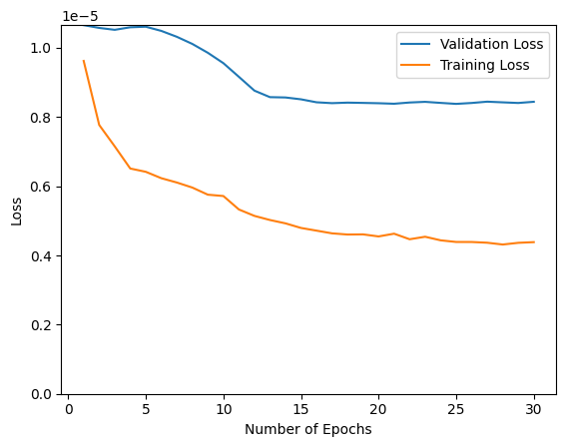
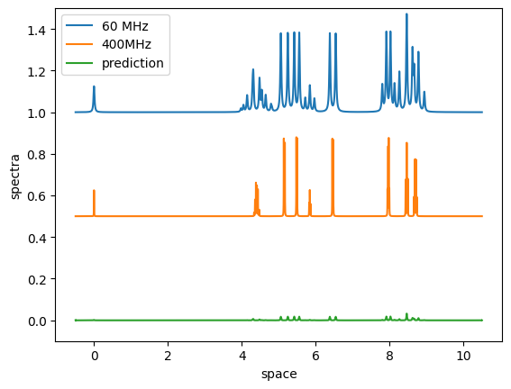
Everything is figure-out-able
Number of Layers = 5
Number of Channels = 128
Kernel Size = 3
Drop Out = 0.5
Optimizer = Adam
Learning Rate = 0.0001
Batch Size = 192

Slide 21
Everything is figure-out-able
Number of Layers = 7
Number of Channels = 128
Kernel Size = 3
Drop Out = 0.24687753171076915
Optimizer = Adam
Learning Rate = 0.0009788339328753053
Batch Size = 64

Slide 22
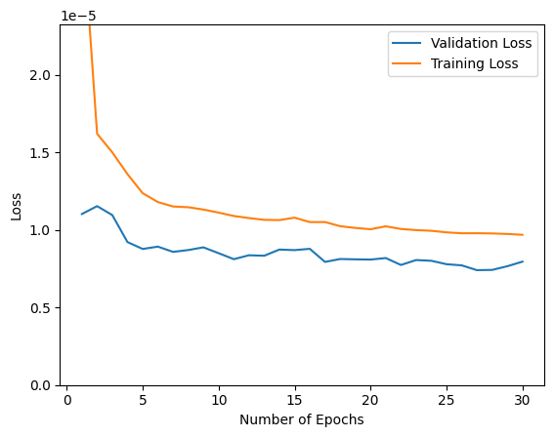
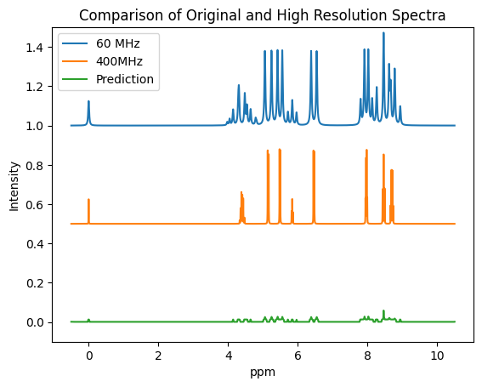
Everything is figure-out-able
Number of Layers = 9
Number of Channels = 32
Kernel Size = 5
Drop Out = 0.34097925346491736
Optimizer = Adam
Learning Rate = 0.004037847206733172
Batch Size = 64

Slide 23
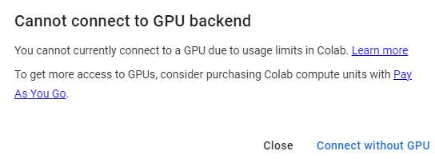
Everything is figure-out-able
Number of Layers = 9
Number of Channels = 32
Kernel Size = 5
Drop Out = 0.34097925346491736
Optimizer = Adam
Learning Rate = 0.004037847206733172
Batch Size = 64

Slide 24
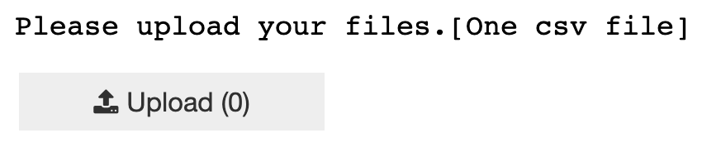


Explore Interaction
1.Upload
2.Convert
csv to df
3.export
df to csv
Notes:
Then we took a break and dive into something new, which is integrating user interactive components into model.
As I mentioned before, users just need to upload the file, then our model will do the data conversion, run everything, and export an output csv file for you.

Slide 25
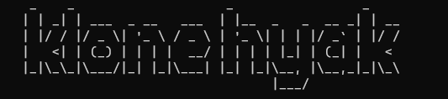
Everything is figure-out-able
Create Hyak Account
Prepare Environment
Modify Code
Generate Data
Submit job

Slide 26
Everything is figure-out-able
Create Hyak Account
Prepare Environment
Modify Code
Generate Data
Submit job

Slide 27
Everything is figure-out-able
optuna.importance.get_param_importances()

Slide 28
Everything is figure-out-able
optuna.importance.get_param_importances()

Slide 29
ISOTOPe story time
WHAT ARCHITECTURE WILL WORK?
03
23
MLP
Conv VAE
Transformer
CNN
04
23
HOW TO OPTIMIZE THE MODEL
0623
The Endline
Comet ML
vs.
Optuna
WHAT IS ISOTOPE
0223
WHAT ENVIRONMENT TO USE
04
23
Google Colab
vs
Jupyter notebook
Everything is figure-out-able
05
23
Hyak !!

Slide 30
The Endline
Plan
Design
Code
Implement
Test
Modify
Thank You

